Slide 1
FUNERAL SEVA
Group Members - Namrata Wange ( 220343120063 ).
Tejashri Sutar ( 220343120108 ).
Omkar S. More ( 220343120062 ).
Project Guide – Mrs. Harshita Maheshwari.

Slide 2
Contents
Introduction
Choice of topic
Proposed System
Methodology
Proposed Approach
Screenshot
System Requirement
Advantages & Limitations
Conclusion
Future Scopes
References

Slide 3
Introduction
Funeral Seva is a web application to help the customer of any cast and any language.
In this application customer can get any information required related to Funeral Services and the ‘Samgri’ needed.
It provides Admin, Vendors and Customers login.
Vendors and admin can add various packages and different ‘Samagri’. .

Slide 4
Choice of topic
This project will help people to give their loved one their final good byes without any difficulties.
Easy & Convenient.

Slide 5
Proposed System
Aim –
It will help People and Vendor.
Proposed System –
Communication can take place through mobile.
Eliminate Intermediates.

Slide 6
Methodology
The objective is to create a web site that can perform the following:-
Connecting HTTPS site through WIFI.
Read the data logically into customer, vender and admin.
Creating a local database.

Slide 7
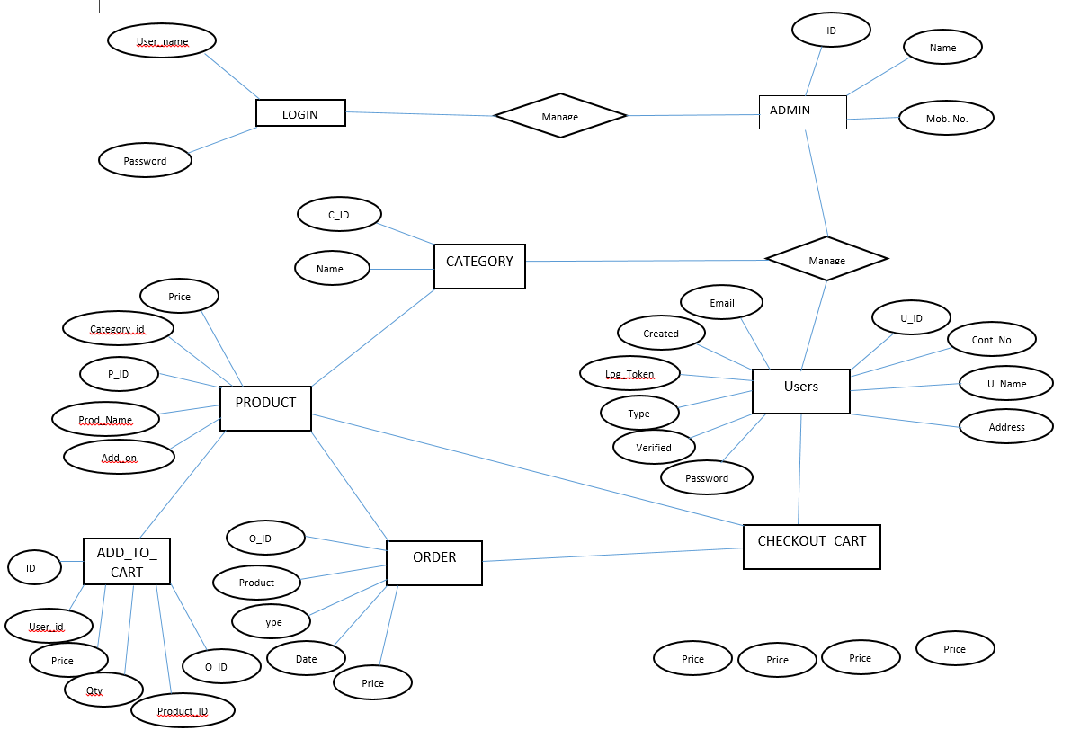
Proposed Approach

Slide 8
Proposed System Model
There are three main modules
Admin
Home
Product Category
All Product
Add Product & Packages
Log Out
Customer
Home
All Product
Order
Validation
Log Out

Slide 9
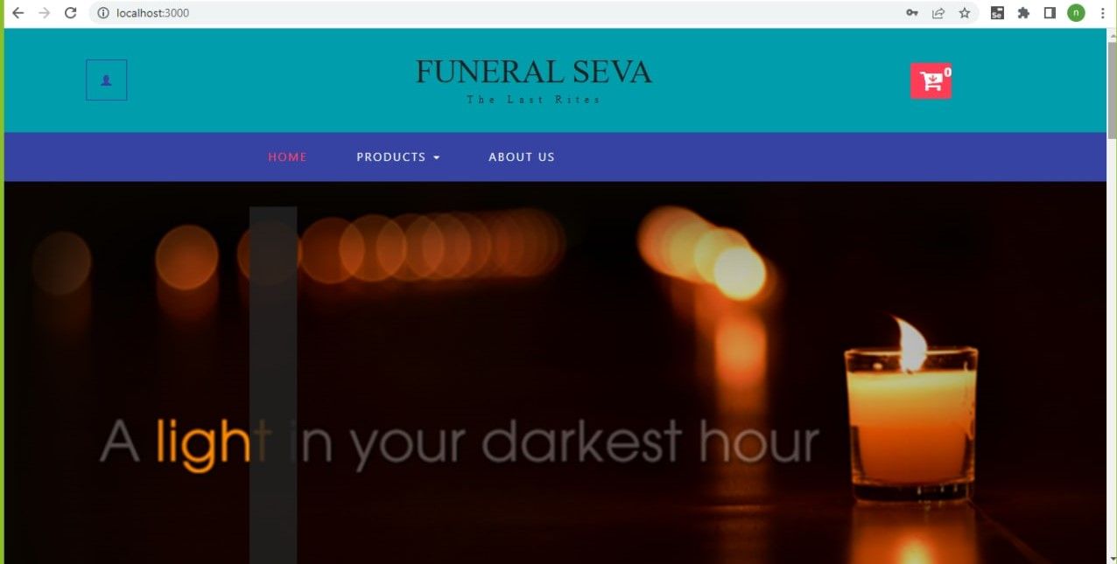

Slide 10
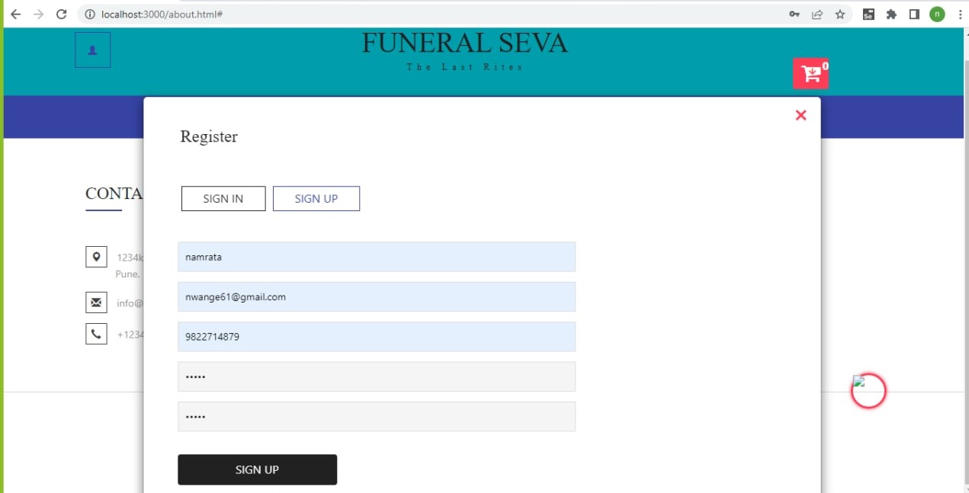

Slide 11
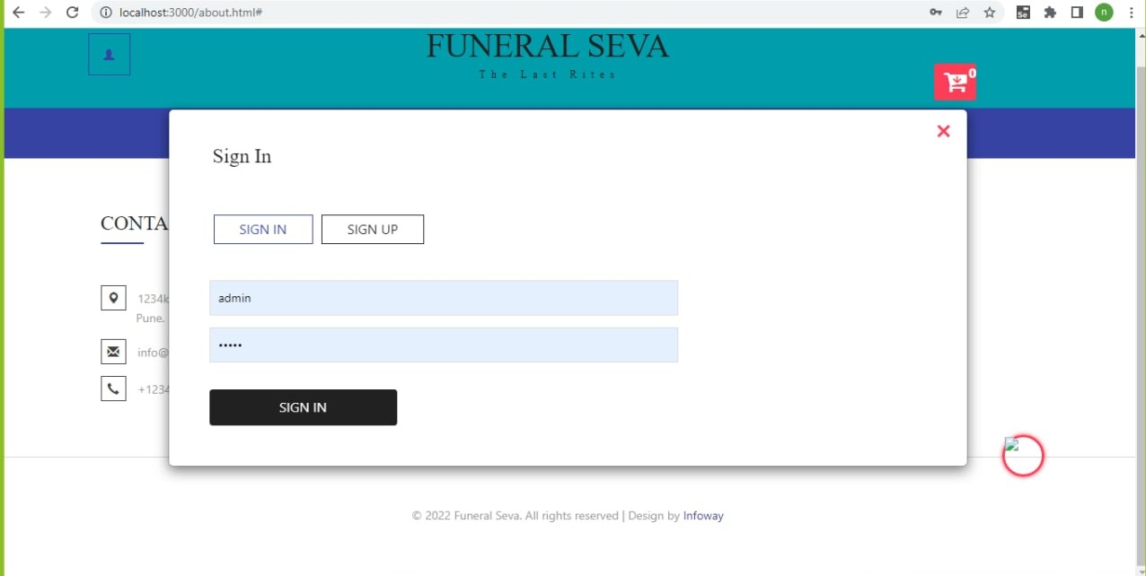

Slide 12
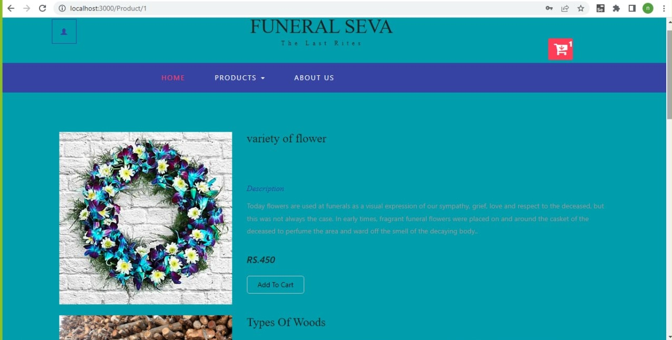

Slide 13
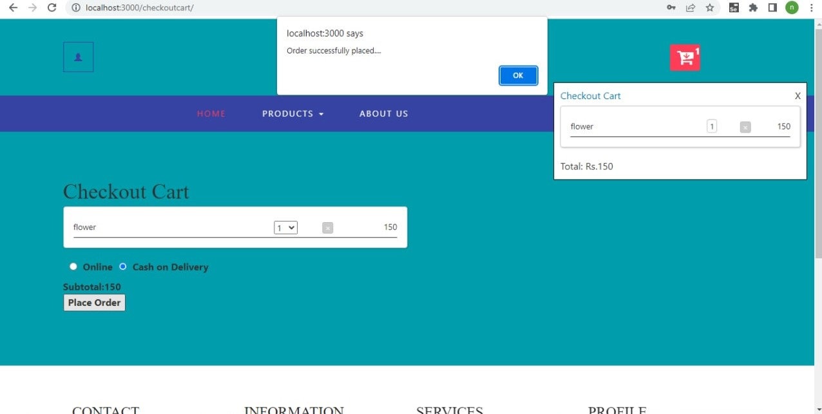

Slide 14
System Requirement
Software Requirement:-
Windows (All Version)
MySQL
Eclipse
VS Code
Hardware Require:-
Processor – i3 & above.
Hard Disk – 4Gb.
Memory – 4Gb RAM.

Slide 15
Technologies Used
React :- Page Layout has been designed in React
Spring Boot :- All front end logic has been written in Spring Boot.
MySQL :- MySQL database is used as database.

Slide 16
Advantages
Easy to use from anywhere.
Saves time and energy.

Slide 17
Limitations
Accurate verification of the users cannot be done online.
It requires an extensive database and memory.

Slide 18
Conclusion
The Funeral Seva web service will be designed and developed to help people stay connected to their culture and ritual in the modern age. This system will make easy and comfortable to the people to give their loved their final goodbyes with proper ritual. It can be improved in future according to rising demands and suggestions of user.

Slide 19
Future Scope
Improvement in Design.
UPI Payment.
Certification.
Mobile Application.
Chat BOT.

Slide 20
References
Mr. Saleel Bagde for Database.
Mrs. Harshita Maheshwari for React JS & also she was our project guide.
A special thanks to Infoway Management who arranged extra lab time for us.

Slide 21
THANK YOU

